Slide 1
Botulism
Assist. Prof. Dr. Hussein ALNaji

Slide 2
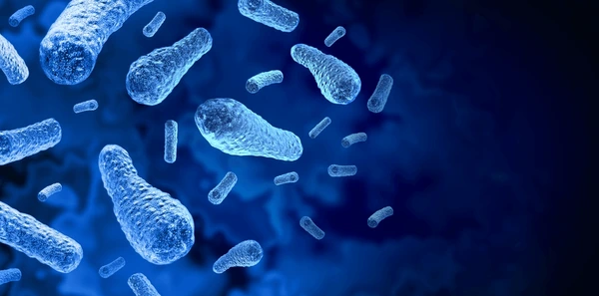
Botulism is a life-threatening disease caused by the ingestion of a potent neurotoxin produced during growth of the Clostridium botulinum bacteria. This neurotoxin is among the most toxic substances known; even microscopic amounts can cause illness or death. In the past, botulism was linked primarily to home-canned foods. In recent decades, however, botulism illnesses have been linked to foods such as unrefrigerated homemade salsa, baked potatoes sealed in aluminum foil, honey (the primary cause of botulism in infants) and fermented fish.

Slide 3
Kinds of Botulism
1- Infant botulism can happen if the spores of the bacteria get into an infant’s intestines.
2- Wound botulism can happen if the spores of the bacteria get into a wound and make a toxin.
3- Foodborne botulism can happen by eating foods that have been contaminated with botulinum toxin.
4- Iatrogenic botulism can happen if too much botulinum toxin is injected for cosmetic reasons, such as for wrinkles, or medical reasons, such as for migraine headaches.
5-Adult intestinal toxemia (also known as adult intestinal colonization) botulism is a very rare kind of botulism

Slide 4
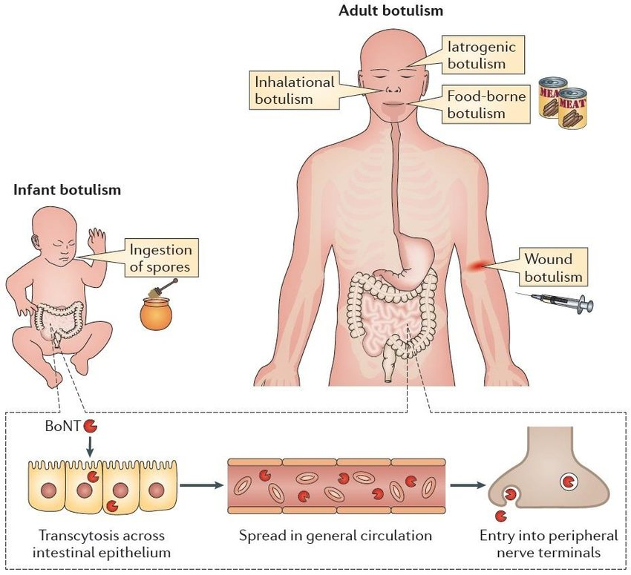

Slide 5
Symptoms
Signs and symptoms might include:
1- Difficulty swallowing 2- Muscle weakness
3- Double vision 4- Drooping eyelids
5- Blurry vision 6- Slurred speech
7- Difficulty breathing 8- Difficulty moving the eyes
Possible signs and symptoms in foodborne botulism might also include:
1- Vomiting & Nausea
2-Stomach pain
3- Diarrhea

Slide 6
Diagnosis and Tests
1- Physical examination
2- To confirm the diagnosis of botulism, your healthcare provider can conduct a test that shows the toxin is present in your blood, stool or vomit.
3- Brain scan.
4- Spinal fluid exam.
5- Nerve and muscle function tests (electromyography).
6- Tensilon test: t uses the drug Tensilon (edrophonium) to help diagnose myasthenia gravis. Tensilon prevents the breakdown of the chemical acetylcholine, a neurotransmitter that nerve cells release to stimulate muscles.

Slide 7
Prevention
Foodborne botulism
1- Refrigerate foods within two hours after cooking. Proper refrigeration prevents the bacteria from producing spores.
2- Cook food thoroughly.
3- Avoid food containers that appear damaged or bulging. (These can be signs of gas produced by the bacteria.)
4- Sterilize home-canned foods in a pressure cooker at 250°F (121°C) for 30 minutes.
5- Throw away foul-smelling preserved foods.

Slide 8
Thank you

